Slide 1
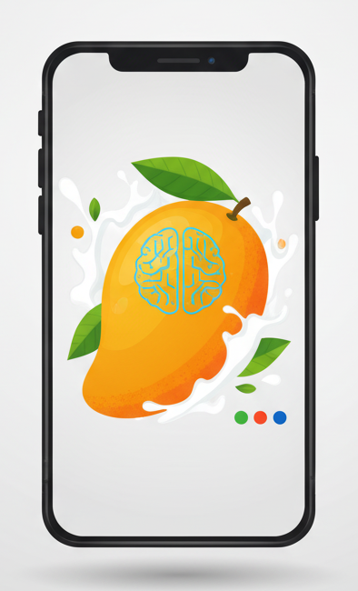
Mobile App for Detecting Artificially Ripened Mangoes Using Computer Vision & Colorimetric Analysis
Team Members: Guide: S Rama Krishna
B. Sri Keerthi Chandra (HU22CSEN0500203)
Lercha Vikas (HU22CSEN0500090)
E. Harsha Vardan Reddy (HU22CSEN0500034)
Guneet Singh (HU22CSEN0500076)

Slide 2
Recap of Project
Artificial ripening of mangoes using calcium carbide and excess ethylene
is a major health concern in India
Consumers cannot identify chemical ripening visually
Lab-based methods are accurate but not affordable or accessible
proposed a hybrid mobile solution combining:
CNN-based visual features
Colorimetric indicators

Slide 3
Actions Taken from Review-1
Feedback Received:
Move beyond conceptual design to actual implementation
Improve robustness under varying lighting conditions
Demonstrate real-time mobile inference
Show measurable results
Actions Taken in Review-2:
Implemented full preprocessing + feature extraction pipeline
Integrated CNN + colorimetric feature fusion
Developed working Android application
Tested system on real mango images

Slide 4
Objectives
Implement the proposed hybrid methodology
Develop a fully working Android application
Integrate trained ML model into mobile environment
Demonstrate real-time detection with real images
Evaluate system performance and reliability

Slide 5
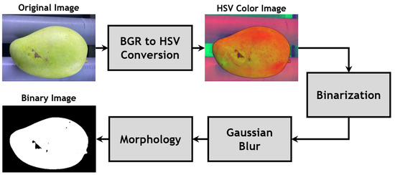
Final Proposed System
User captures mango image via Android app
Image preprocessing & color normalization applied
Colorimetric features extracted (Lab / HSV)
CNN features extracted using lightweight backbone
Feature fusion and classification performed
Output displayed as:
Naturally Ripened
Artificially Ripened
Confidence score + explanation

Slide 6
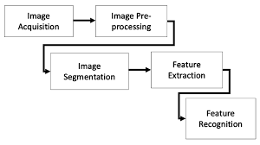
Final System Architecture
UI Layer: Capture → Preview → Result
Preprocessing Module:
Resize
Noise reduction
Illumination correction
Color constancy
Feature Extraction Module:
Colorimetric block
CNN block
Fusion & Classification Module
Result Visualization Module

Slide 7
Implementation Details – Preprocessing
Image resizing and cropping
Illumination normalization to handle real-world lighting
Color constancy correction
Conversion to Lab and HSV color spaces
Improves stability across camera devices

Slide 8
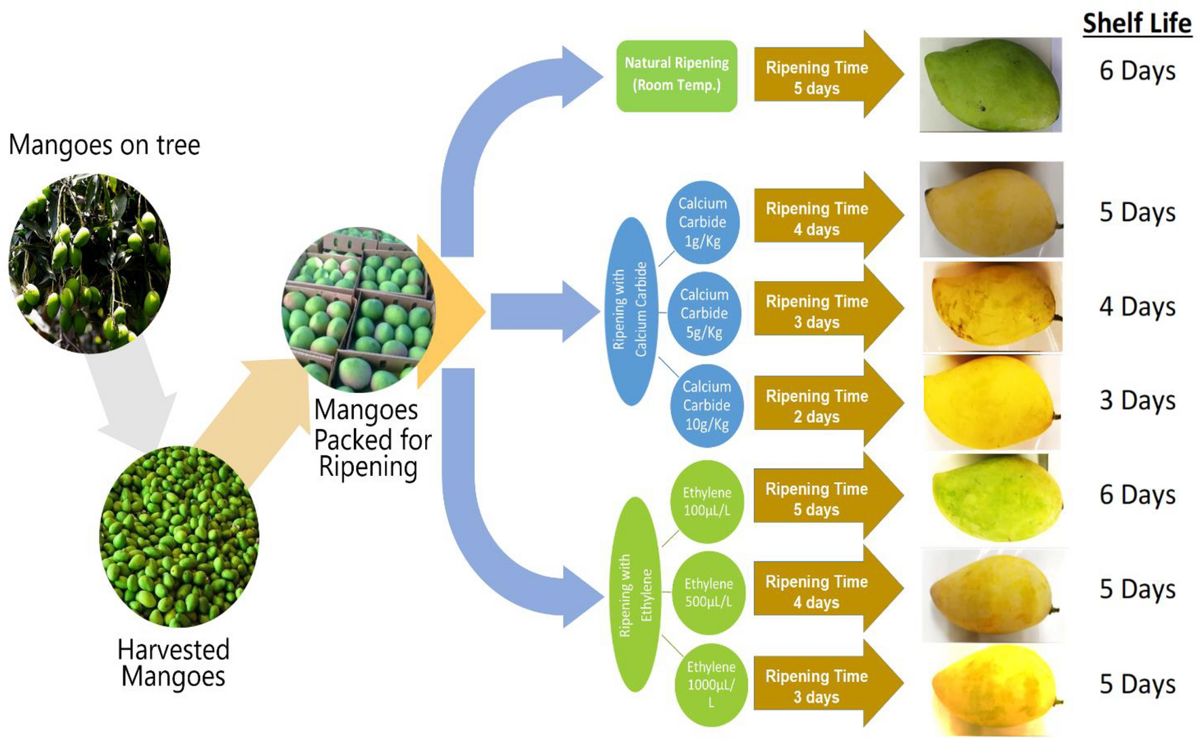
Colorimetric Analysis Implementation
Extracted features:
L*, a*, b* values (Lab space)
Hue angle
Chroma
Saturation
Artificial ripening shows unnatural color uniformity
These metrics help detect chemical influence on ripening

Slide 9
CNN Model Implementation
Lightweight CNN backbone (MobileNet / EfficientNet)
Optimized for mobile inference
Extracts high-level texture and visual features
Reduced model size for faster execution on Android

Slide 10
Feature Fusion & Classification
Concatenation of:
Colorimetric feature vector
CNN embedding vector
Final classifier predicts:
Natural vs Artificial ripening
Improves accuracy over standalone CNN or color methods

Slide 11
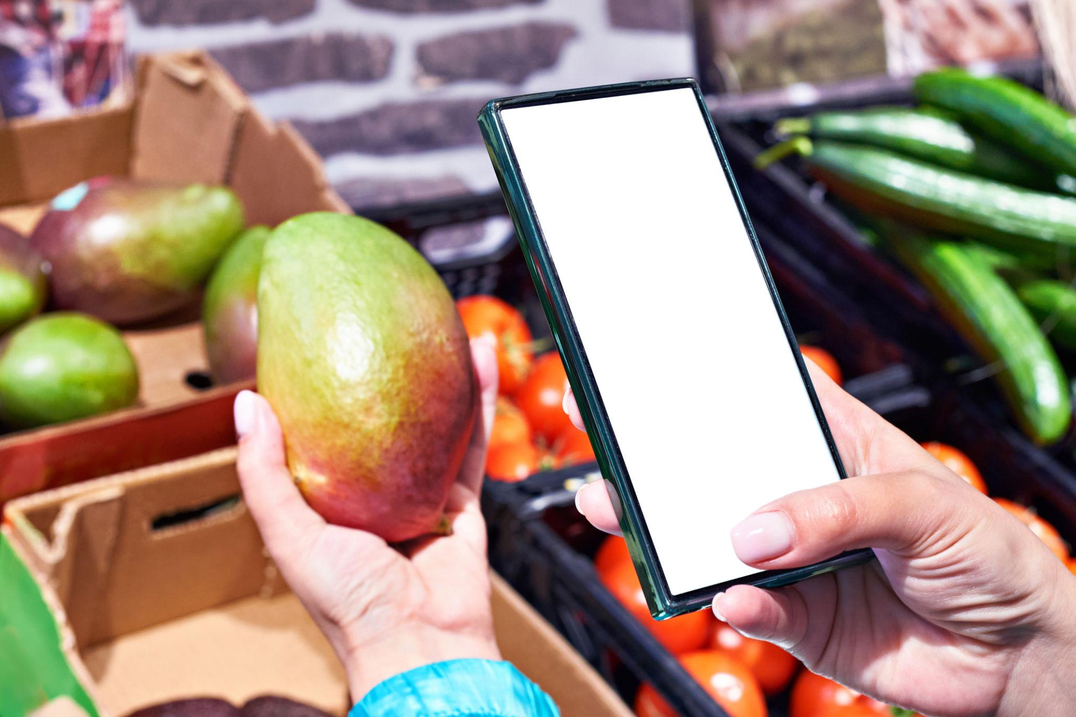
Android App Implementation
Developed using Android Studio
Camera-based image capture
On-device preprocessing and inference
User-friendly interface
Minimal computation delay

Slide 12
Working Demonstration
Live image capture of mango
App processes image in real-time
Displays classification result instantly
Tested using real mango images
All modules integrated and functional

Slide 13
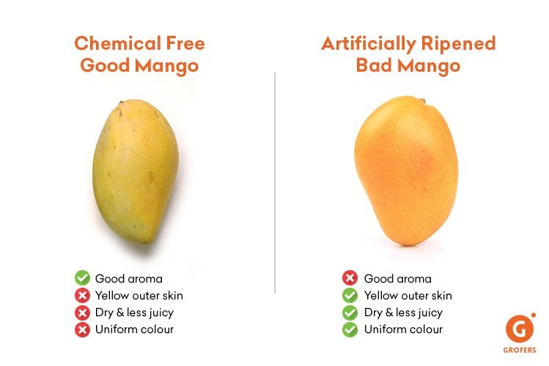
Results & Observations
Hybrid approach outperforms baseline methods
Improved robustness under different lighting conditions
Clear separation between natural and artificial ripening
Fast and reliable mobile predictions

Slide 14
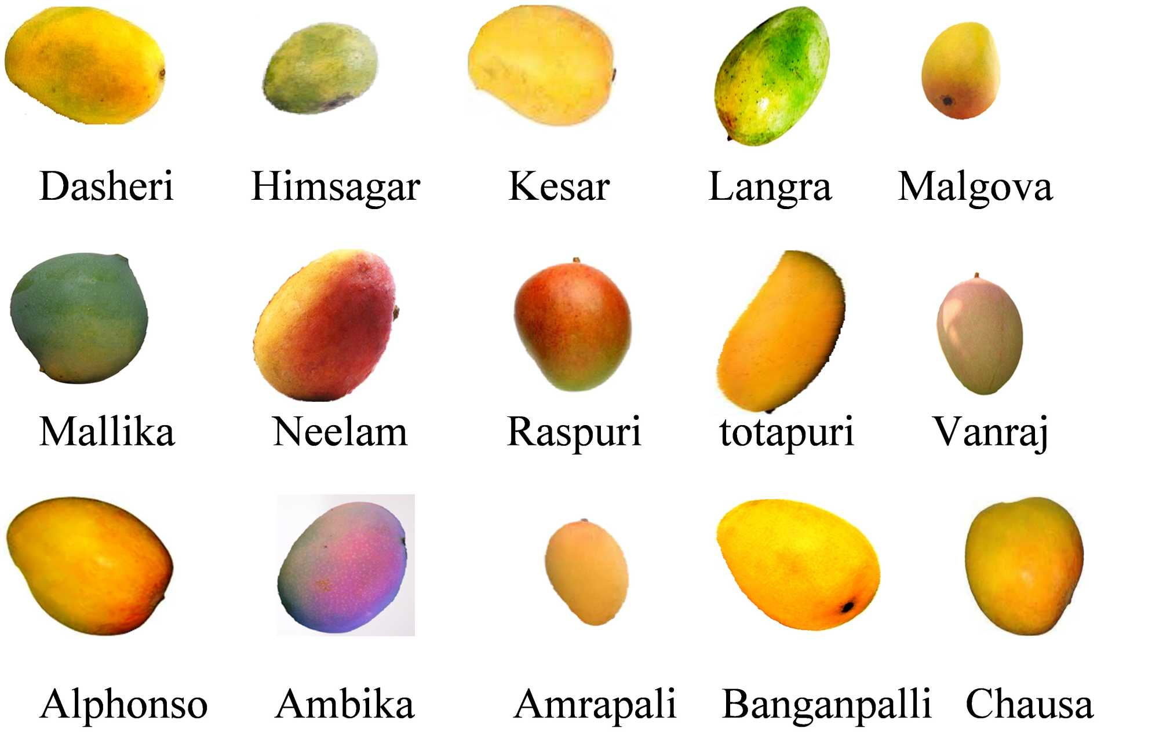
Applications
Consumers for safe fruit consumption
Traders for quality veriafication
Food safety authorities
Awareness against food adulteration

Slide 15
Limitations
Lighting extremes may still affect accuracy
Limited dataset size
Currently focused only on mangoes
Detection accuracy depends on mobile camera quality and resolution.
Dust, wax coating, or surface damage on mangoes can interfere with feature extraction.
Real-time processing may slightly lag on older mobile devices.

Slide 16
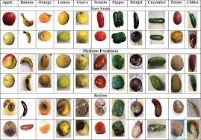
Future Enhancements
Expand dataset across seasons
Support additional fruits
Use deep learning-based color correction
Cloud-assisted model updates
Multi-language UI support

Slide 17
Conclusion
Successfully implemented a working mobile-based detection system
Addresses a real-world public health issue
Hybrid CNN + colorimetric approach improves reliability
System is affordable, portable, and practical

